Slide 1
2022–23 FAFSA® Form on StudentAid.gov Preview Presentation
September 2021
Notes:
2022–23 FAFSA® Form on StudentAid.gov Preview Presentation title slide

Slide 2
Topics
Overview
Home and Log In Views
Dependent Student With Parental Data View
Independent Student View
My FAFSA® View
SAR View
FAFSA® Corrections View
Auto-Zero EFC (Skipping the Remaining Financial Questions) View
Special Circumstances View
Special Circumstance–Unsubsidized Loan Only View
Homeless Circumstance View
Additional Resources View
Notes:
2021-22 Topics slide

Slide 3
Overview
The 2022–23 Free Application for Federal Student Aid (FAFSA^{®)} form preview presentation provides screenshots that financial aid professionals, mentors, and counselors can use as a guide for the 2022–23 web application. The screenshots and information provided can be used to create/modify presentations for professional trainings and high school nights.
The screenshots are intended to show the majority of the questions displayed on the FAFSA form; however, most applicants and/or parents are unlikely to need to answer all the questions when completing the form.
The screenshots used in this presentation show examples of what the FAFSA® form will look like.
The 2022–23 version of the FAFSA® form will be available for applicants to use on Oct. 1, 2021.
The 2022–23 web demonstration site will be available on Sept. 27, 2021.
Notes:
2022-23 Overview slide

Slide 4
Overview (continued, part 2)
The following are key features of the FAFSA® form on StudentAid.gov:
Students and parents may begin, complete, and submit a new or renewal FAFSA form for the 2022–23 FAFSA form processing cycle.
Students and parents who are eligible may use the IRS Data Retrieval Tool (IRS DRT) to electronically transfer federal tax return information into a FAFSA form.
Students and parents may be eligible to transfer their FAFSA information into a state aid application. Participating states include Iowa, Minnesota, Mississippi, New Jersey, New York, Pennsylvania, and Vermont.
Parents that have multiple students who need to file an application may be eligible to transfer their FAFSA information into a new application from the original student’s confirmation page.
Students will be able to view additional information about the schools they selected on their FAFSA form for easy comparison of schools.
Students and parents can correct or update an application once it is been processed.
Students and parents can save an application and resume where they left off on the myStudentAid mobile app and vice versa.
Notes:
2022-23 Overview slide (continued, part 2)

Slide 5
Home View page
FAFSA® Home and Log In Views
Notes:
FAFSA Form Home and Log In Views

Slide 6
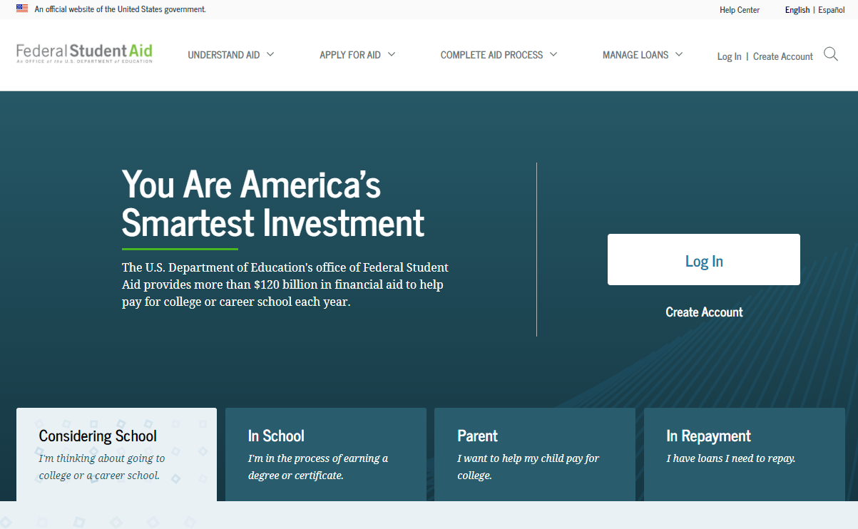
StudentAid.gov Home
Notes:
StudentAid.gov home view

Slide 7
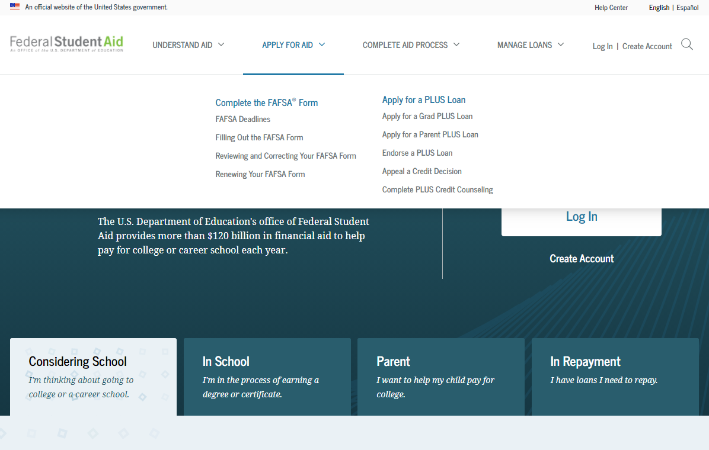
Apply for Aid
Notes:
Apply for Aid header view
If the applicant is navigating to the FAFSA form from the StudentAid.gov home page, he or she can select “Apply for Aid” from the page header, then select “Complete the FAFSA® Form.”

Slide 8
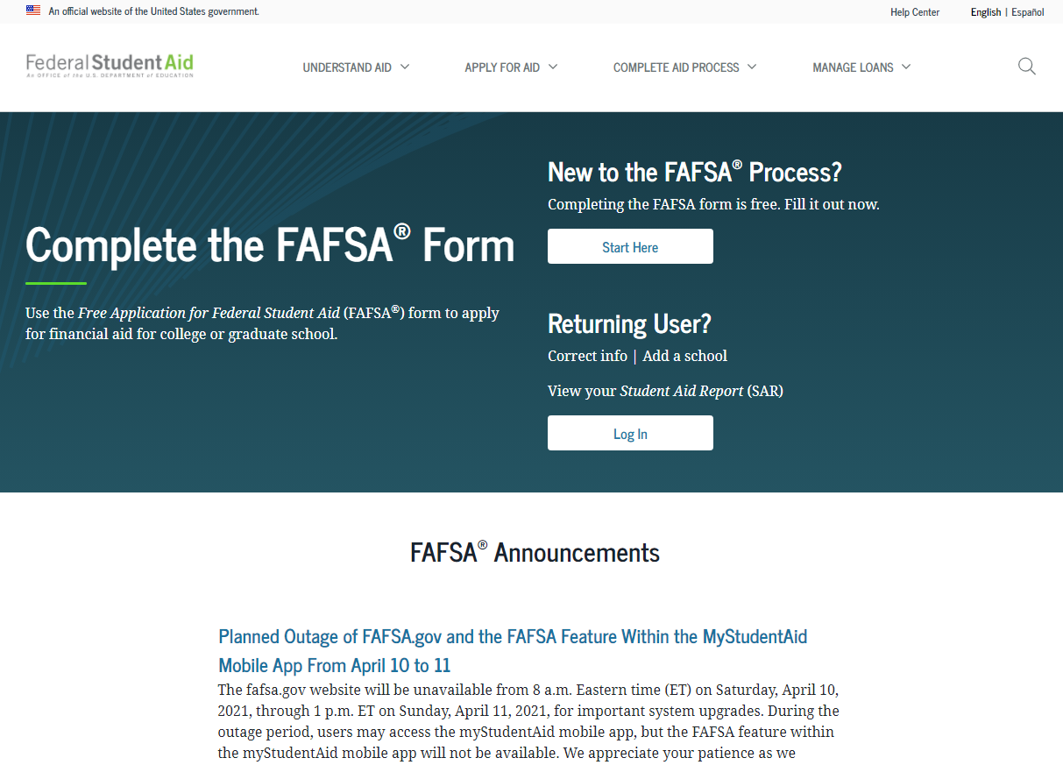
FAFSA® Form Welcome Page
Notes:
FAFSA Form Welcome page view
The applicant may have a direct link to the FAFSA form or may arrive from the FAFSA form home page. The “FAFSA Form Welcome” page directs new users to the “Start Here” button and returning users to the “Log In” button. For the purpose of this presentation, the applicant is beginning a new application.

Slide 9
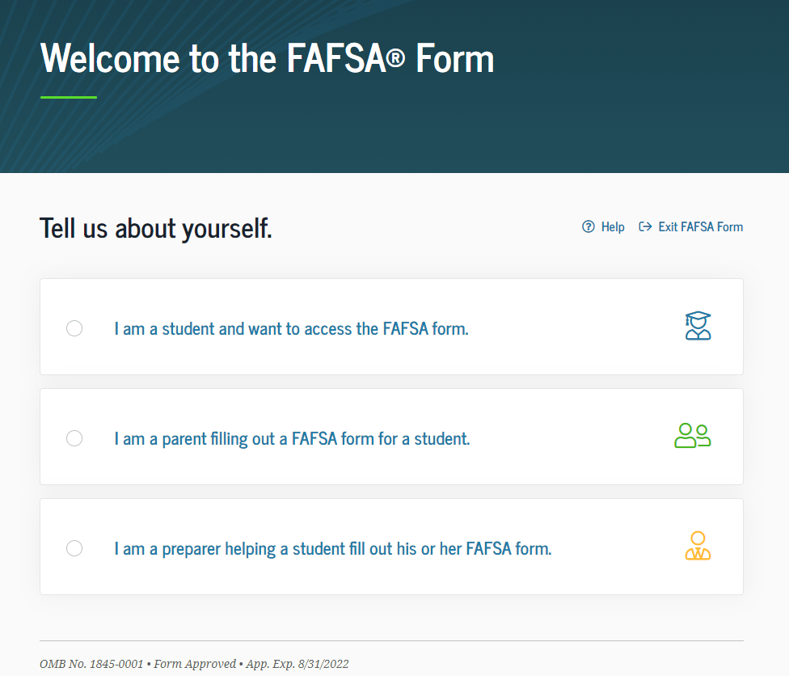
Role Selection
Notes:
Role Selection (1 of 3) view
The user will select the applicable role to fill out the FAFSA form: student, parent of a student, or preparer helping a student.
For this presentation, the user selects a student role. In the dependent student section, the parent will also log in to sign and submit the FAFSA form.

Slide 10
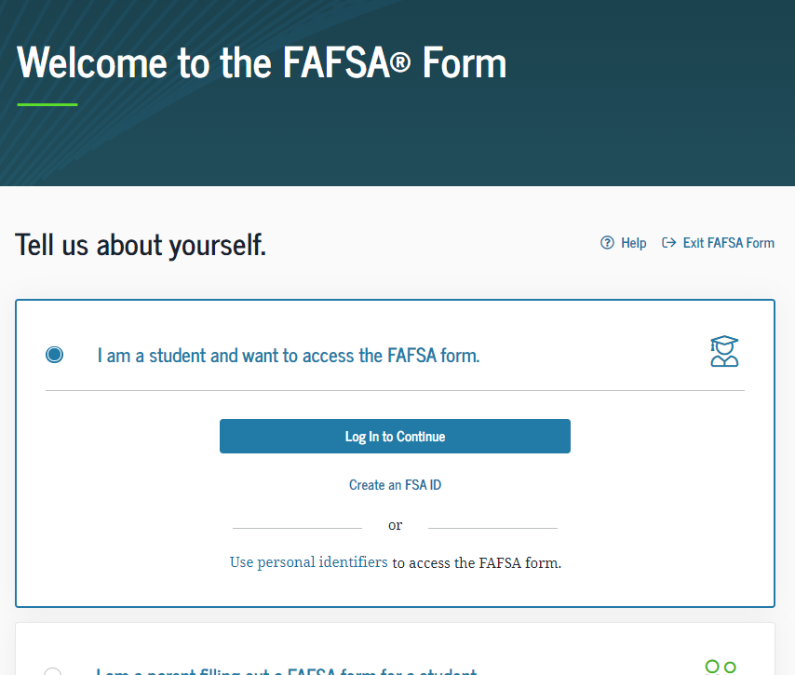
Role Selection Dependent
Notes:
Role Selection (2 of 3) view
The form will ask the user to log in or create an FSA ID or start the form with personal identifiers (next slide).

Slide 11
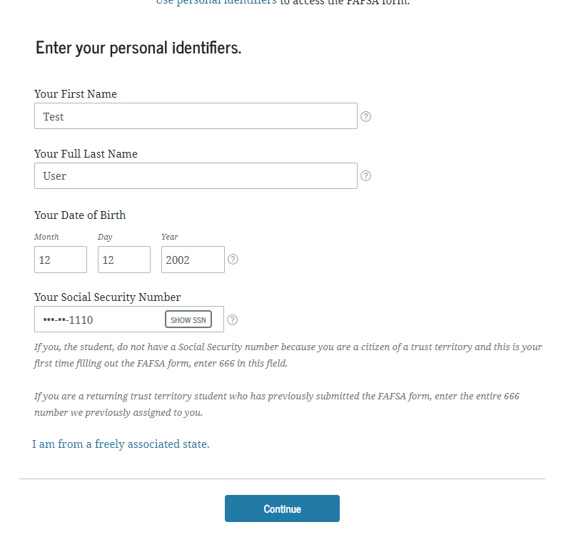
Role Selection
Notes:
Role Selection (3 of 3) view
The user may also choose to begin the FAFSA form with personal identifiers: first name, last name, date of birth, and Social Security number.
Once the user has entered in his or her personal identifiers, he or she will select “Continue.”

Slide 12
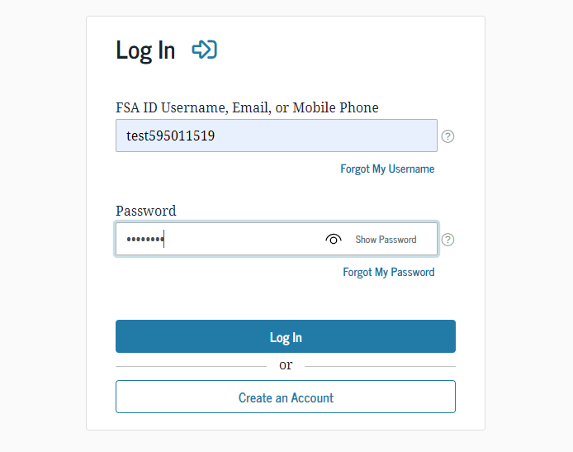
Log In Page
Notes:
Log In Page view
If the user has an FSA ID account, he or she will be prompted to log in with his or her credentials. If not, the user can select "Create an Account."

Slide 13
Dependent Student with Parental Data
Notes:
Dependent Student with Parental Data

Slide 14
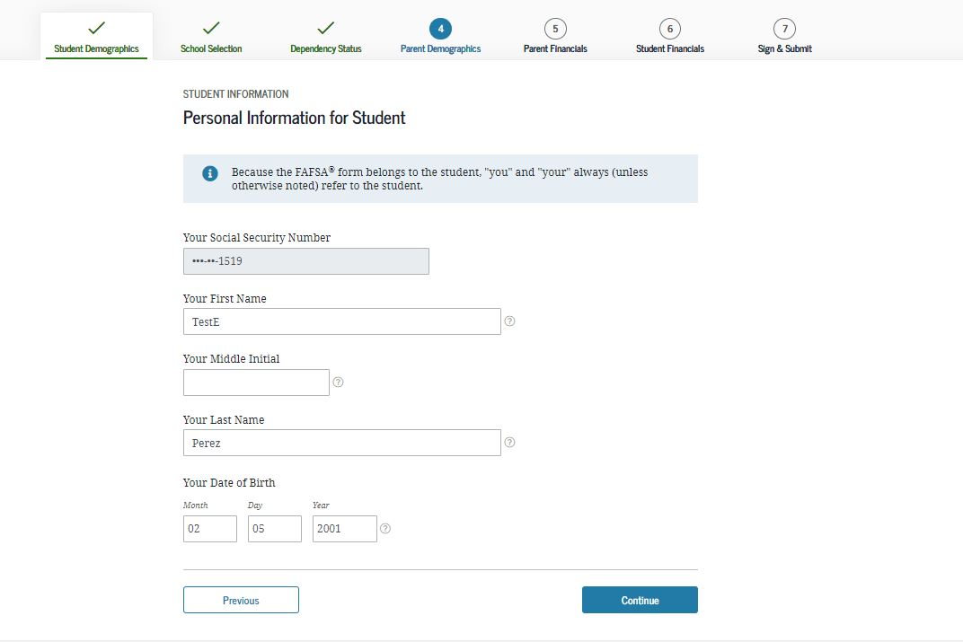
Personal Information for Student
Notes:
Personal Information for Student view
This is one of multiple pages on fafsa.gov that explains that “you” and “your” are referencing the student. Other pages where this messaging appears includes the "Search for High School," "Student Marital Status," "Parent Marital Status," and "Student Tax Filing Status." ​
Note: This is the first view for the Student Demographics section.

Slide 15
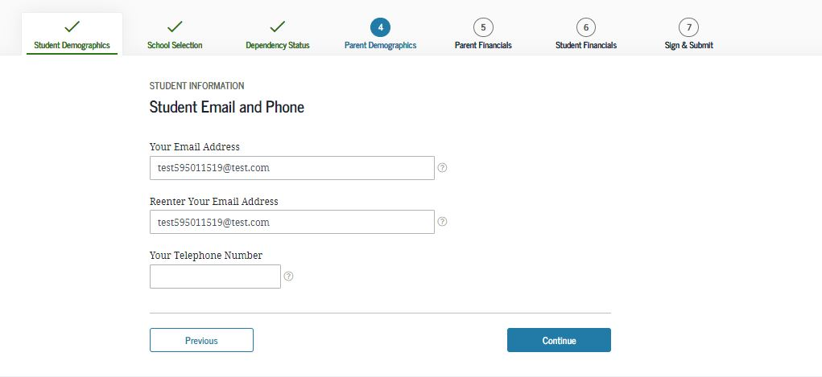
Student Email and Phone
Notes:
Student Email and Phone view
It is beneficial for the student to include an email address on the FAFSA form in order to receive important communications about the student’s financial aid.

Slide 16
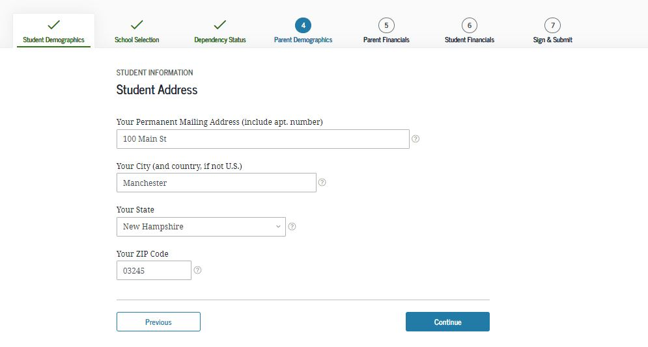
Student Address
Notes:
Student Address view

Slide 17
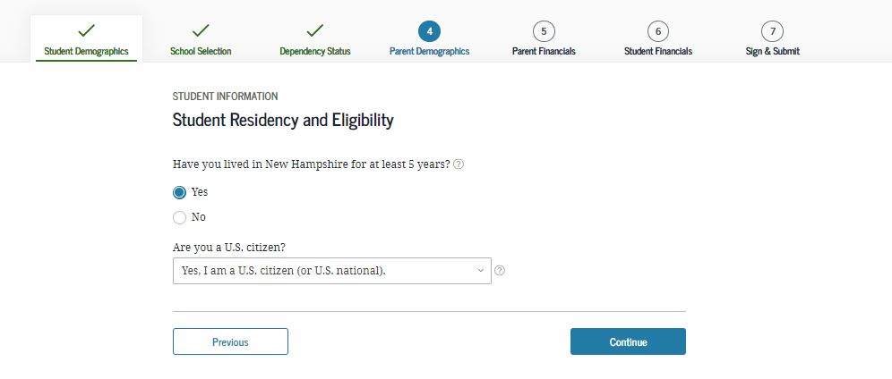
Student Residency and Eligibility
Notes:
Student Residency and Eligibility view

Slide 18
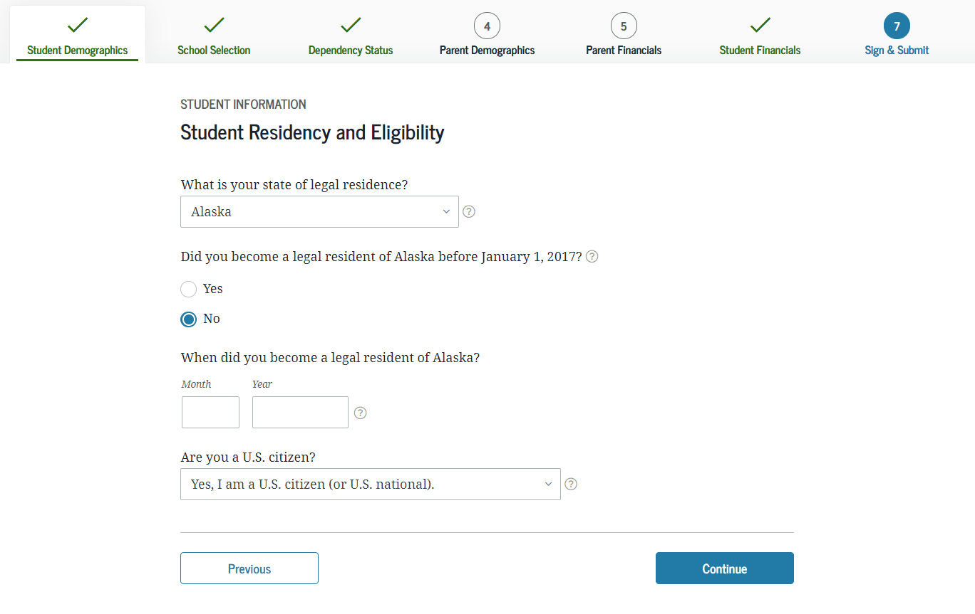
State of Legal Residence
Notes:
State of Legal Residence view

Slide 19
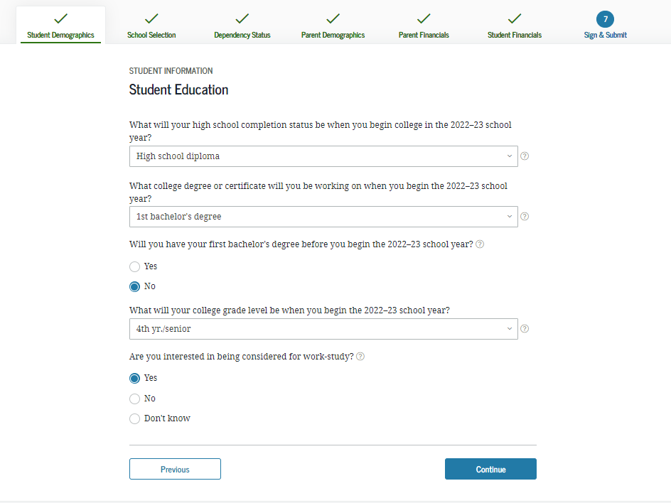
Student Education
Notes:
Student Education view

Slide 20
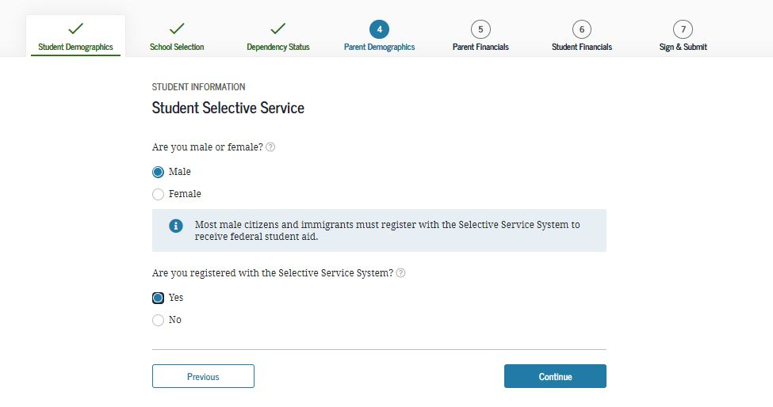
Student Selective Service
Notes:
Student Selective Service view
The response to this question is used to determine if the user needs to register with the Selective Service System. The answer to the Selective Service question will not impact the applicant’s eligibility to receive federal student aid.

Slide 21
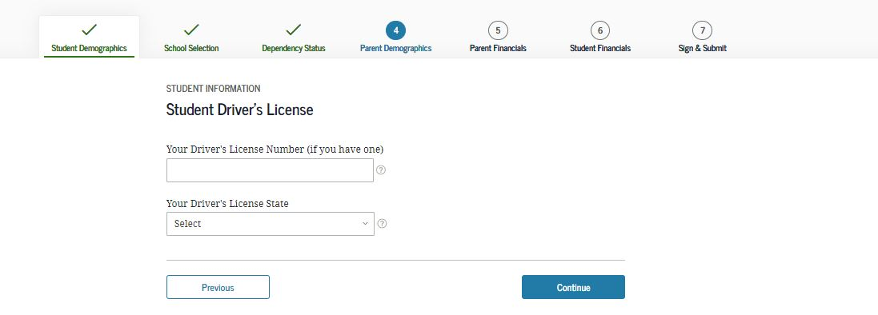
Student Driver’s License
Notes:
Student Driver’s License view

Slide 22
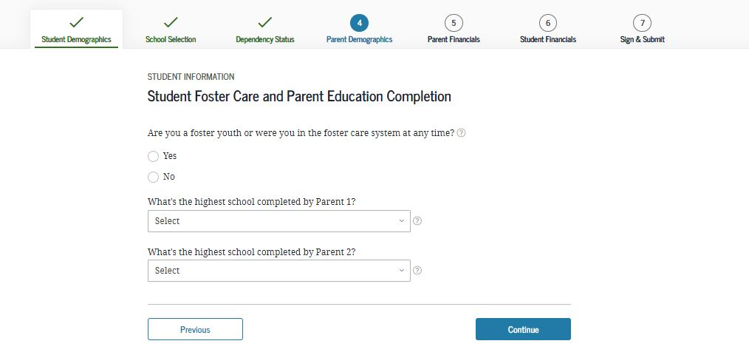
Student Foster Care and Parent Education Completion
Notes:
Student Foster Care and Parent Education Completion view

Slide 23
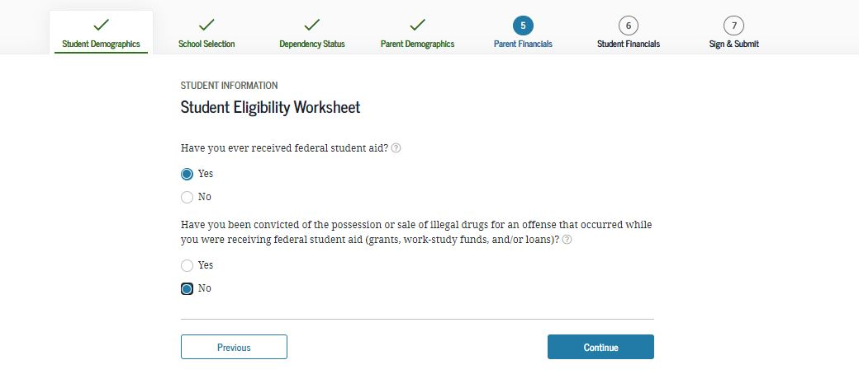
Student Eligibility Worksheet
Notes:
Student Eligibility Worksheet view
The answers to the student eligibility worksheet will not impact the applicant’s eligibility to receive federal student aid.

Slide 24
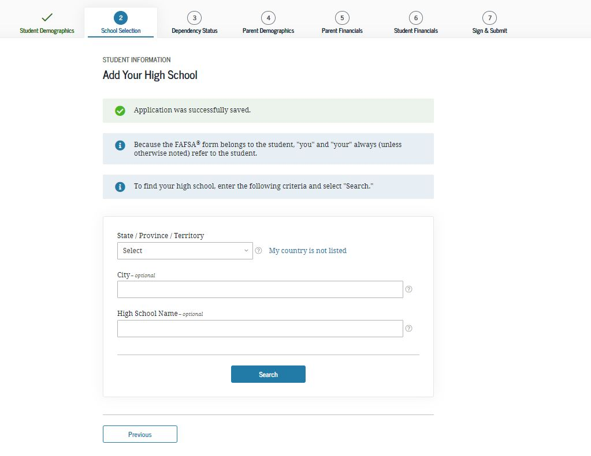
Search for High School
Notes:
Search for High School view
This is the first page for the School Selection section.

Slide 25
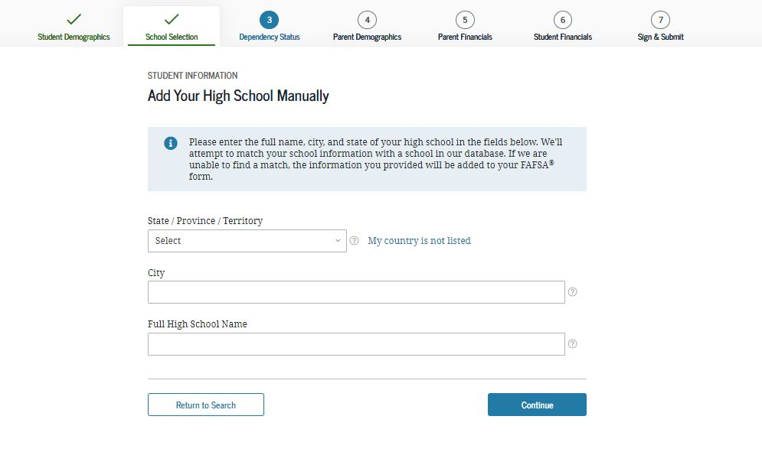
Add Your High School Manually
Notes:
Add Your High School Manually view
New: This functionality has been updated to allow the applicant to enter the full name, city, and state of the high school in the fields on this screen.

Slide 26
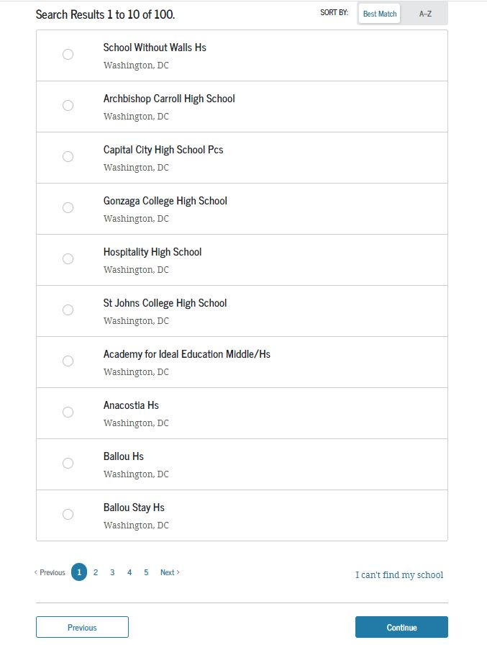
High School Search Results
Notes:
High School Search Results view

Slide 27
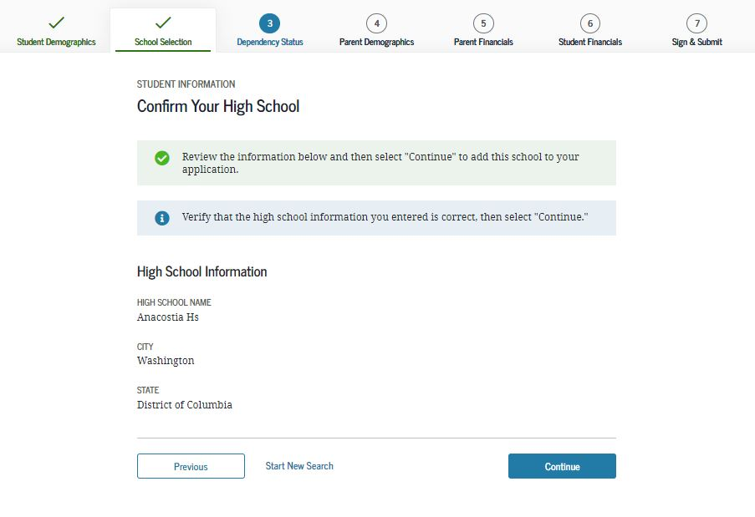
Confirm Your High School
Notes:
Confirm Your High School view

Slide 28
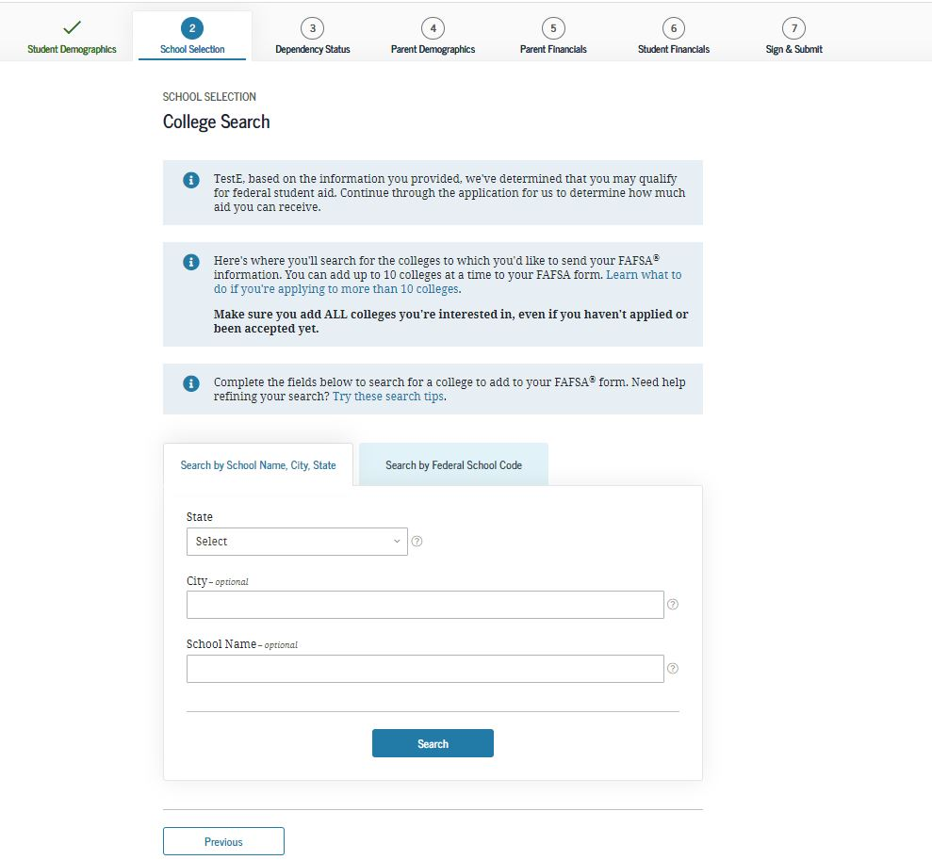
College Search
Notes:
College Search view

Slide 29
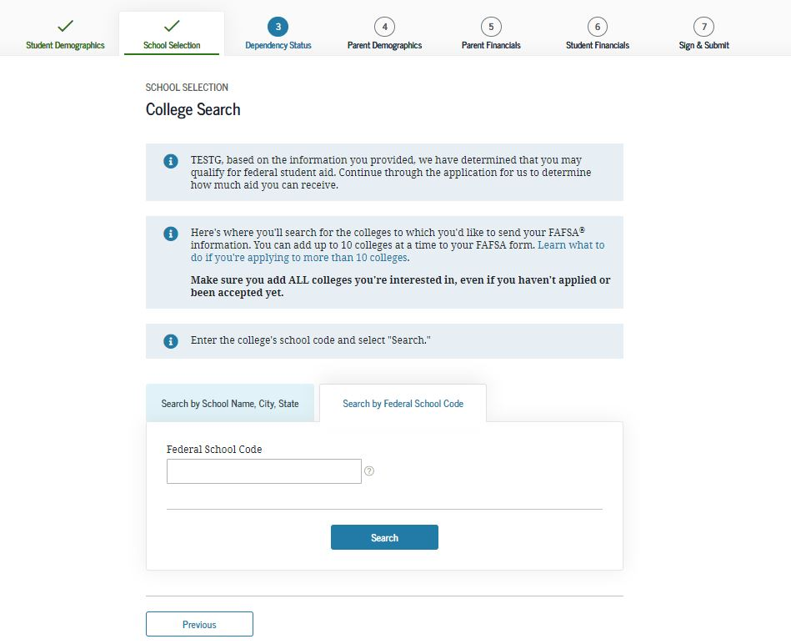
Search by Federal School Code
Notes:
Search by Federal School Code view

Slide 30
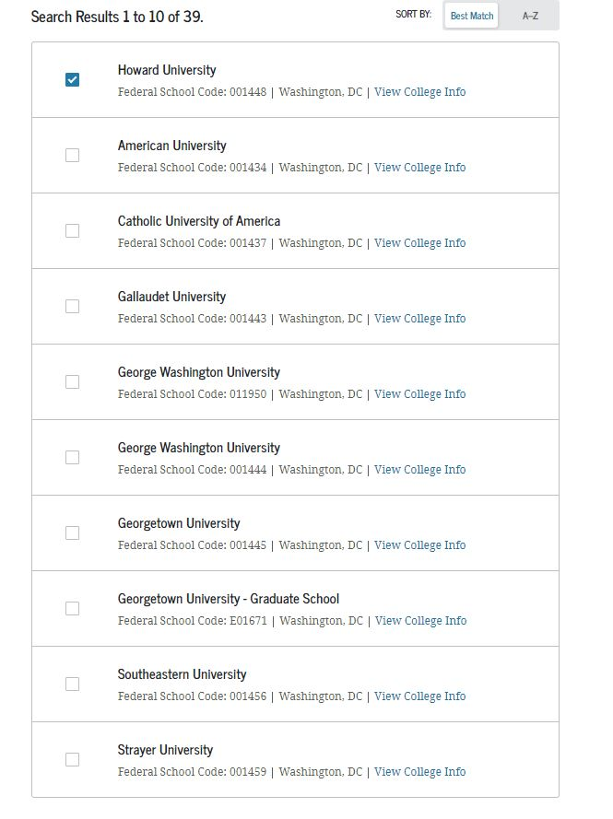
College Search Results
Notes:
College Search Results view

Slide 31
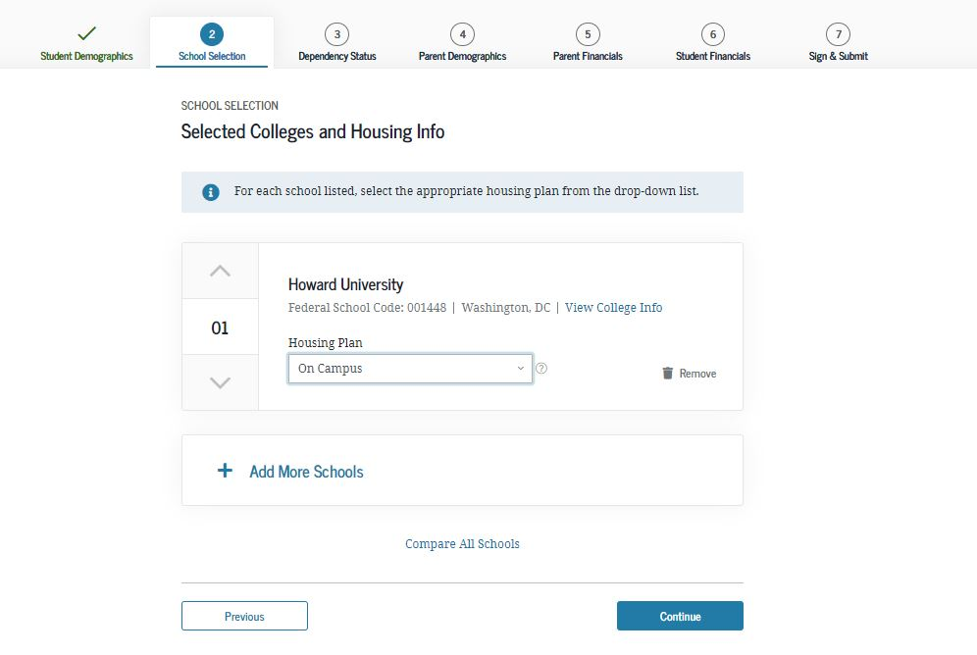
Selected Colleges and Housing Info
Notes:
Selected Colleges and Housing Info view
The applicant can reorder schools on this page which will not affect federal student aid but can affect state/school aid.

Slide 32
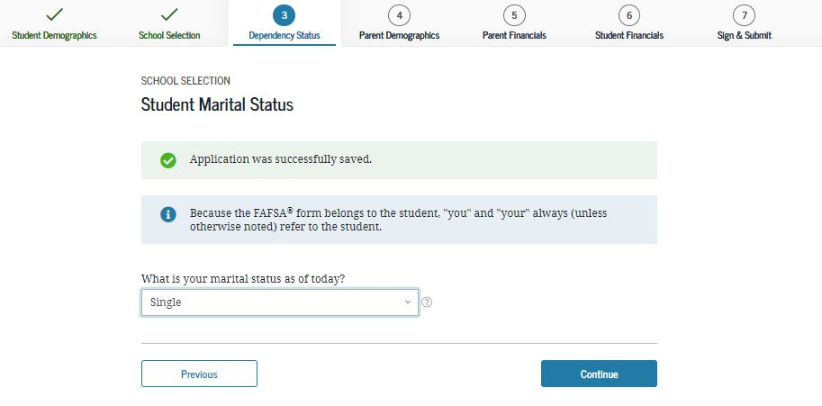
Student Marital Status
Notes:
Student Marital Status view
This is the first page of the Dependency Status section.

Slide 33
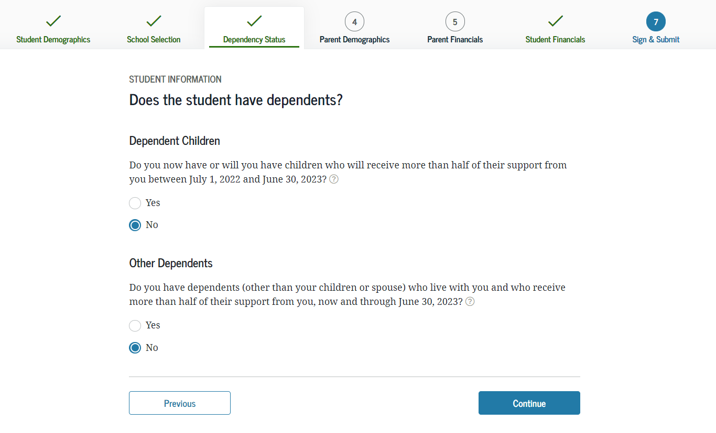
Does the Student Have Dependents?
Notes:
Does the Student Have Dependents? view

Slide 34
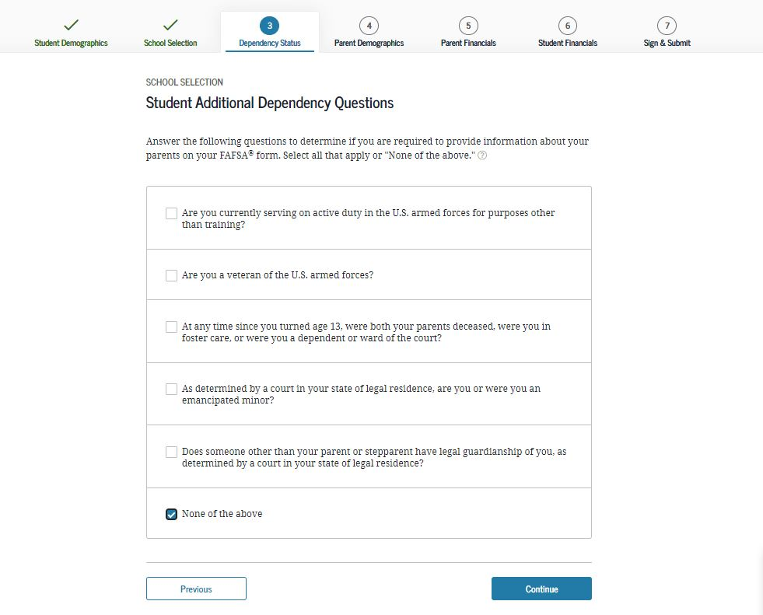
Student Additional Dependency Questions
Notes:
Student Additional Dependency Questions view

Slide 35
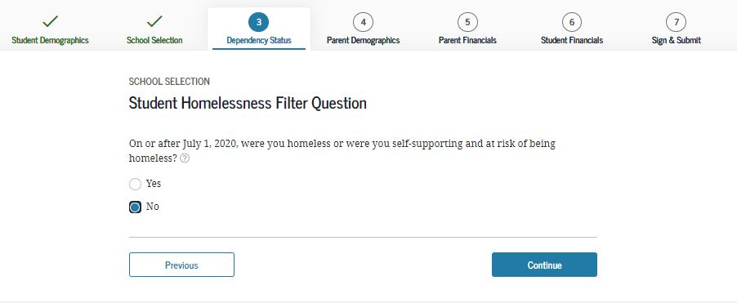
Student Homelessness Filter Questions
Notes:
Student Homelessness Filter Question view

Slide 36
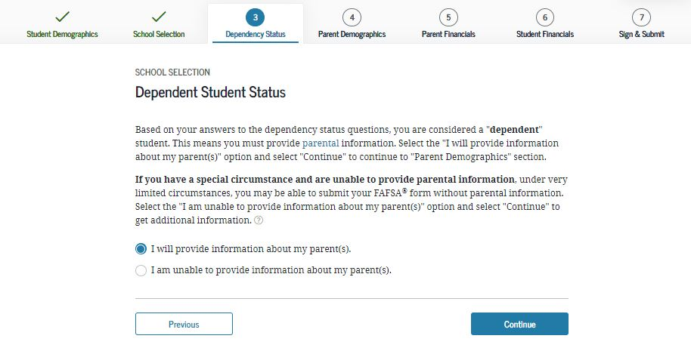
Dependent Student Status
Notes:
Dependent Student Status view
This page only displays if it has been determined that the applicant is considered to be a dependent student.

Slide 37
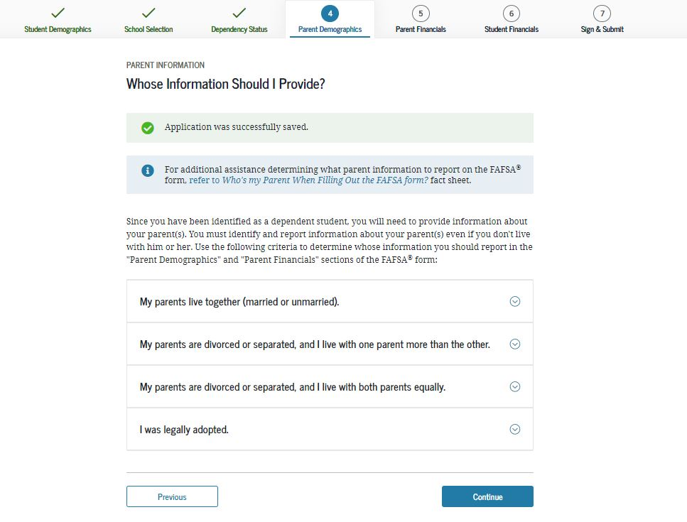
Whose Information Should I Provide?
Notes:
Whose Information Should I Provide? View
This is first view of the Parent Demographics section.

Slide 38
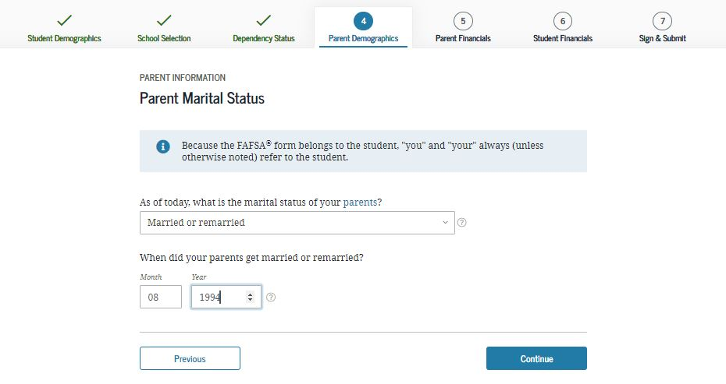
Parent Marital Status
Notes:
Parent Marital Status view

Slide 39
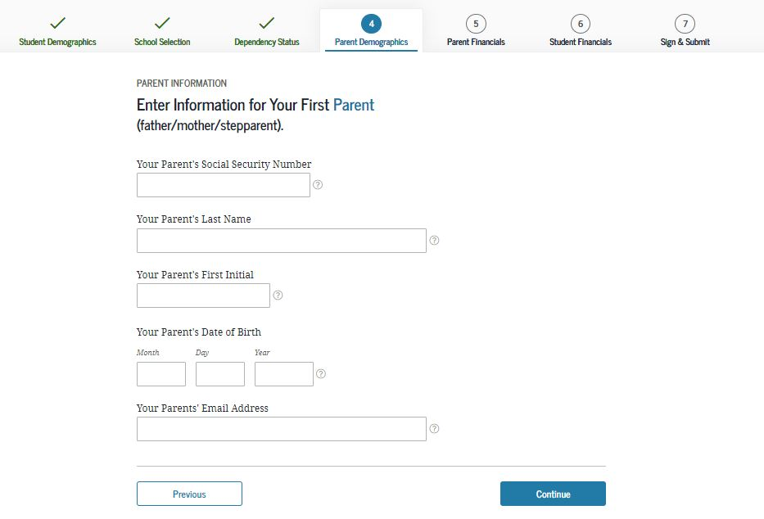
Personal Information for First Parent
Notes:
Personal Information for First Parent view

Slide 40
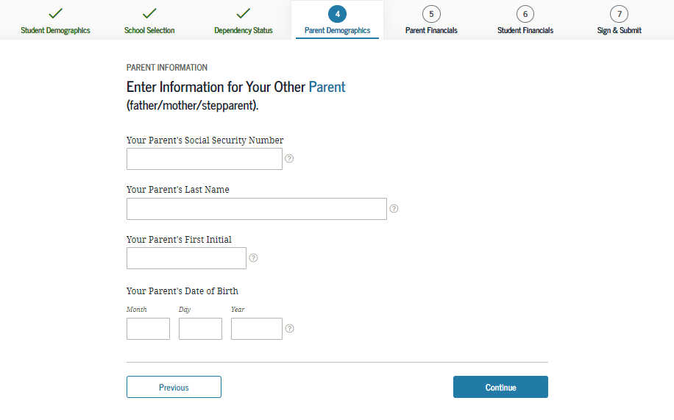
Personal Information for Other Parent
Notes:
Personal Information for Other Parent view

Slide 41
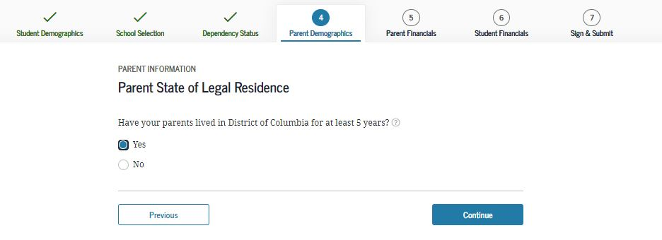
Parent State of Legal Residence
Notes:
Parent State of Legal Residence view

Slide 42
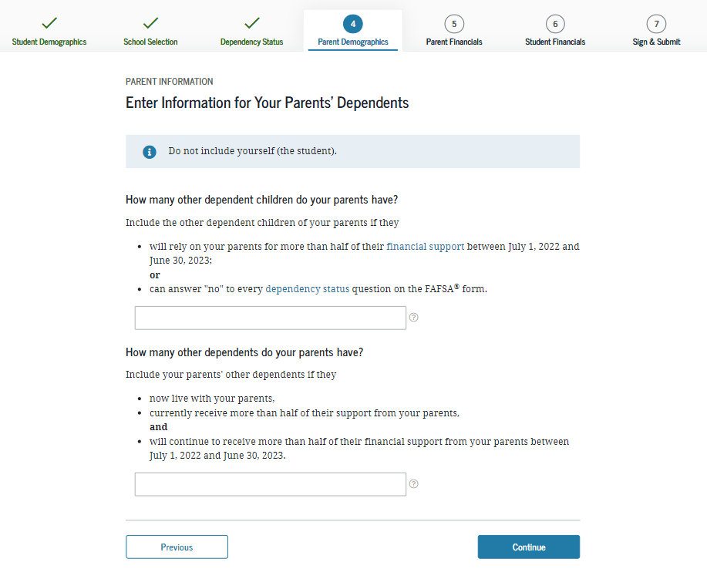
Enter Information for Your Parent’s Dependents (2 of 2)
Notes:
Enter Information for Your Parent’s Dependents view.

Slide 43
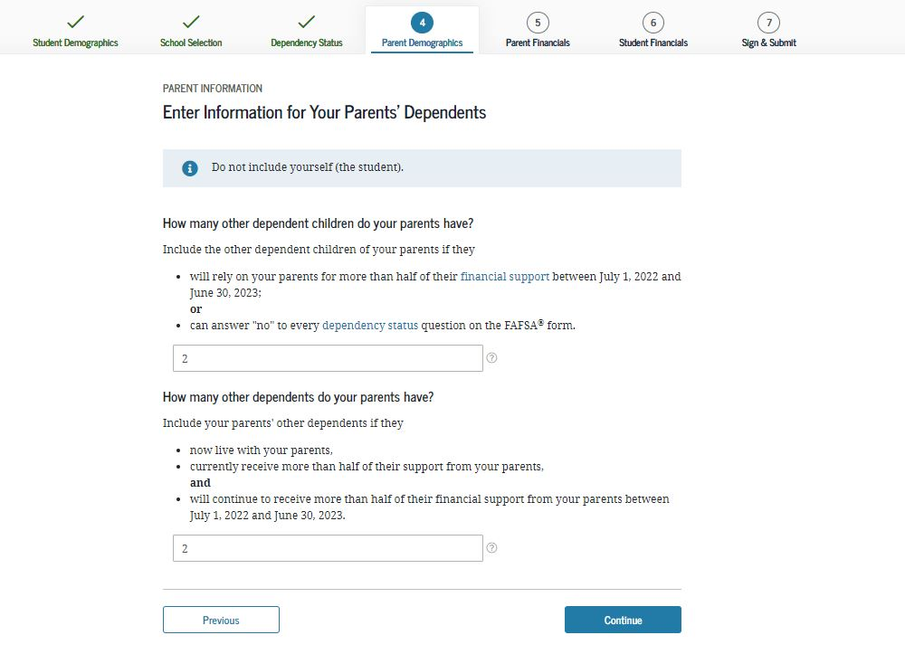
Enter Information for Your Parent’s Dependents
Notes:
Enter Information for Your Parent’s Dependents view
Note: In this view, the parent has additional dependents.

Slide 44
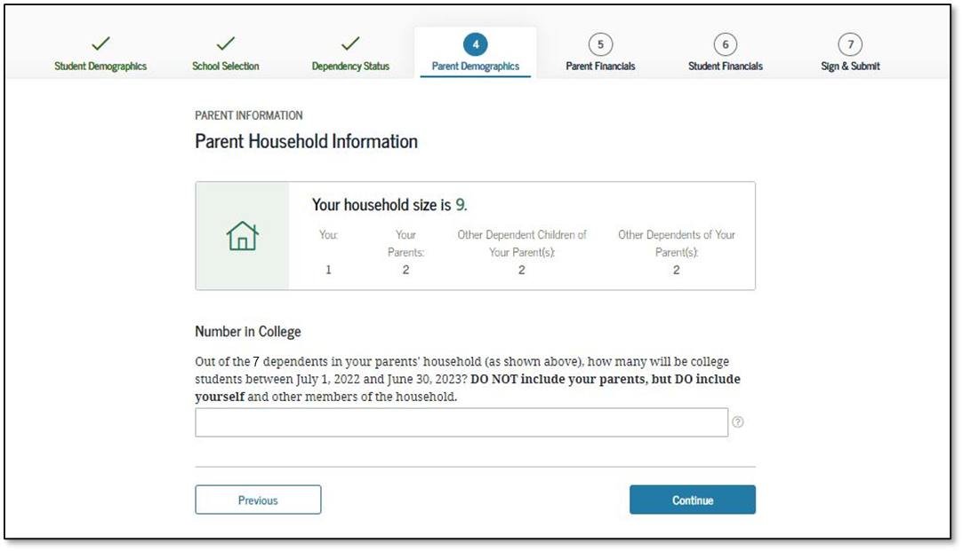
Parent Household Information
Notes:
Parent Household Information view
New: Household size is calculated based on previous answers. The applicant will enter the number of household members in college, including himself or herself.

Slide 45
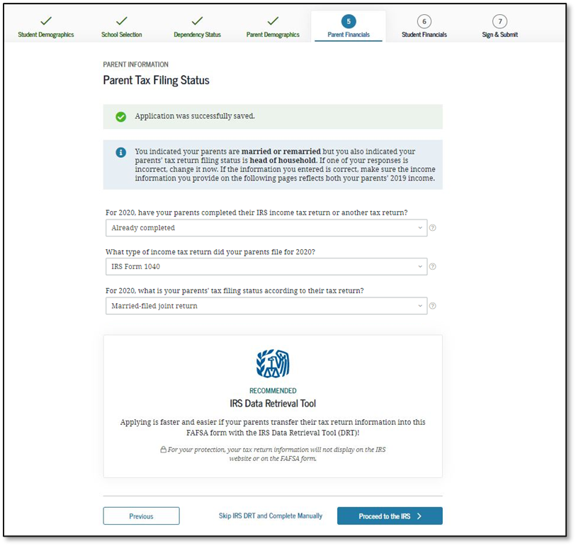
Parent Tax Filing Status
Notes:
Parent Tax Filing Status view
This view is displayed when the parent chooses not to use the IRS Data Retrieval Tool (DRT) on the previous view. An additional opportunity is presented to the parent to determine if he or she would like to link to the IRS for his or her financial information or to continue to enter it manually.
This is the first view in the Parent Financials section.

Slide 46
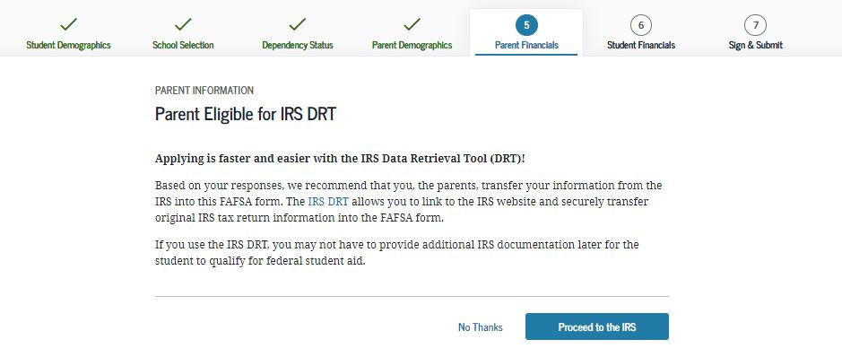
Parent Eligible for IRS DRT
Notes:
Parent Eligible for IRS DRT view

Slide 47
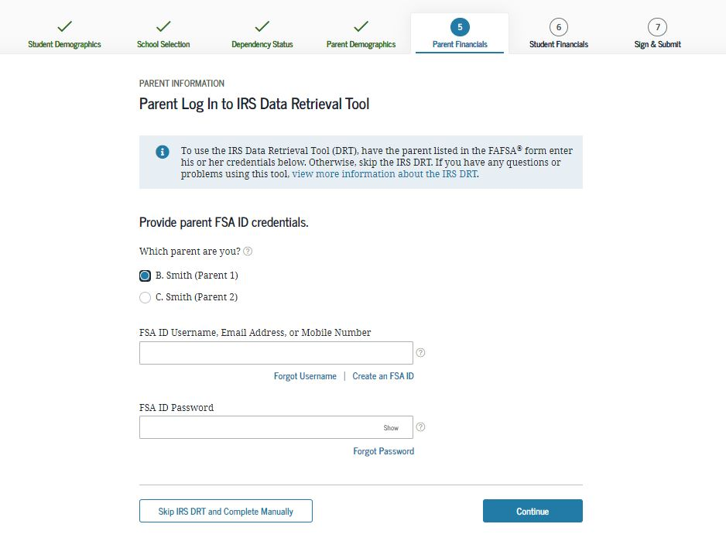
Parent Log In to IRS Data Retrieval Tool
Notes:
Parent Log in to IRS Data Retrieval Tool view
This screen only shows if the parent decides to use the IRS Data Retrieval Tool. In this example, the parent has indicated that he or she is married or living together.

Slide 48
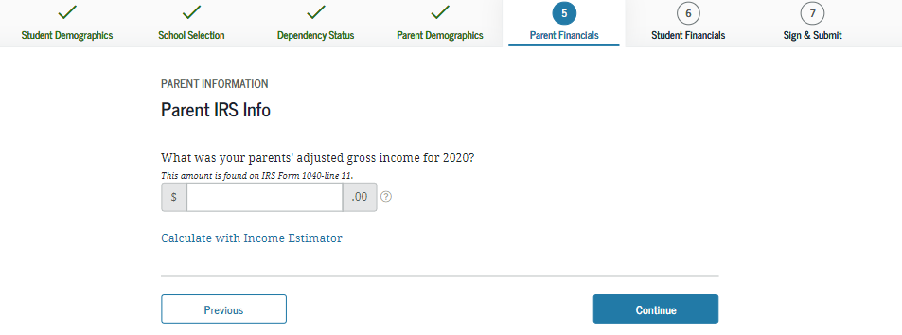
Parent IRS Info
Notes:
Parent IRS Info view
If the parent is either ineligible or decides not to use the IRS DRT, he or she will be required to enter his or her financial information manually.

Slide 49
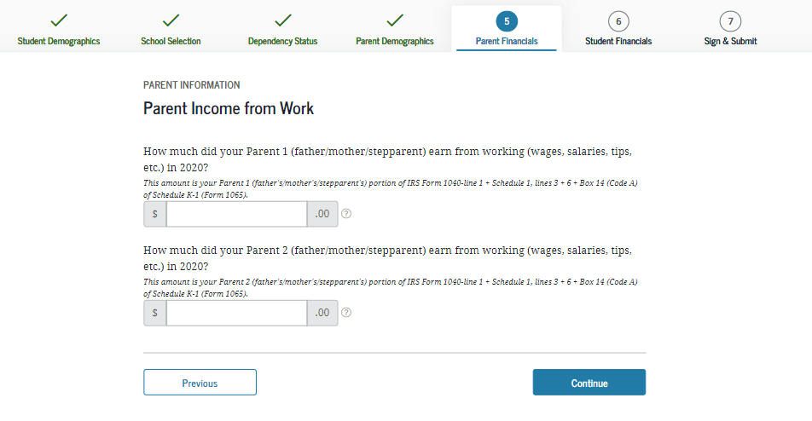
Parent Income from Work
Notes:
Parent Income from Work view

Slide 50
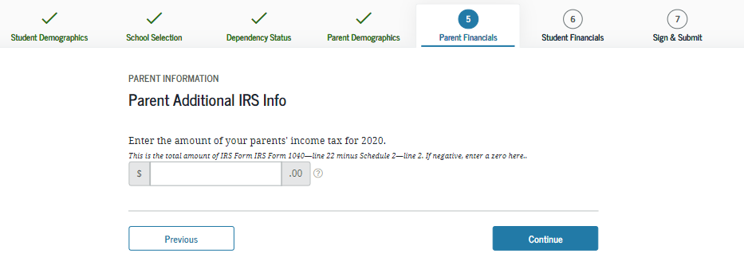
Parent Additional IRS Info
Notes:
Parent Additional IRS Info view

Slide 51
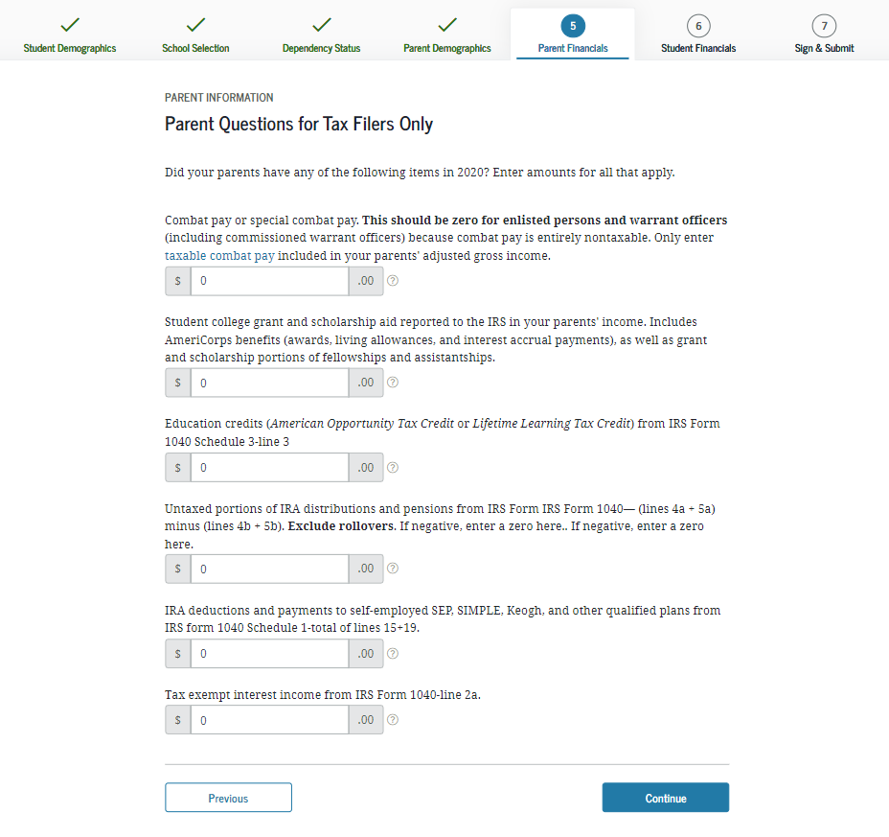
Parent Questions for Tax Filers Only
Notes:
Parent Questions for Tax Filers Only view

Slide 52
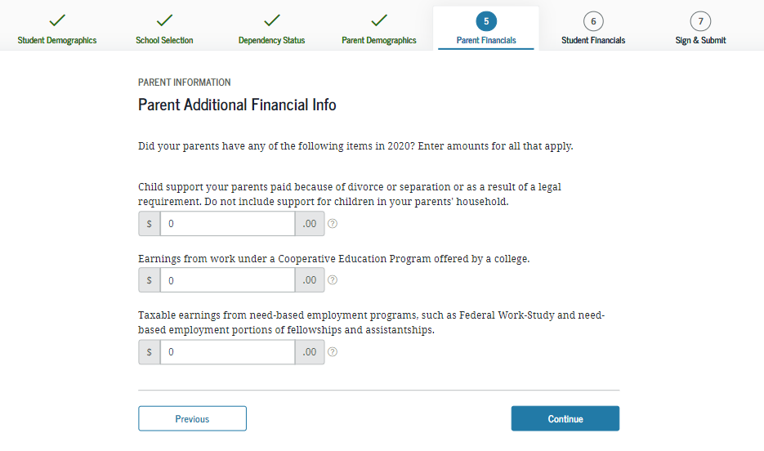
Parent Additional Financial Info
Notes:
Parent Additional Financial Info view

Slide 53
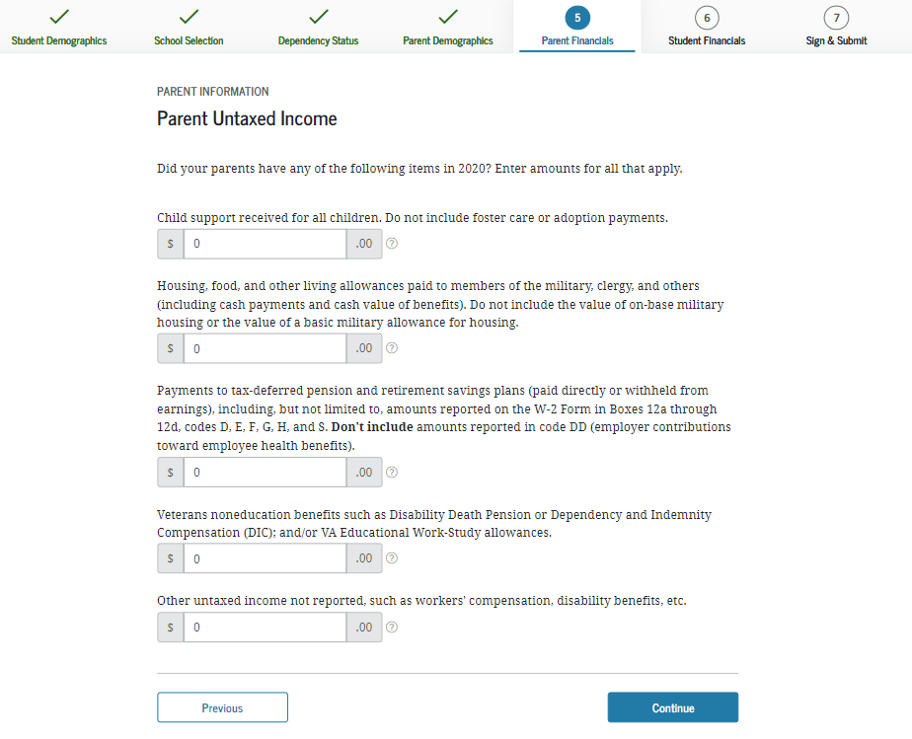
Parent Untaxed Income
Notes:
Parent Untaxed Income view

Slide 54
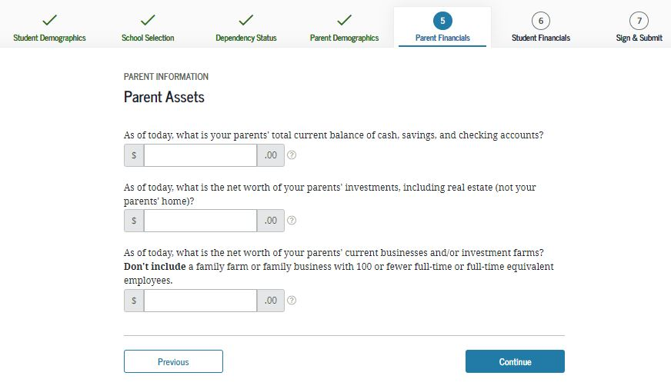
Parent Assets
Notes:
Parent Assets view

Slide 55
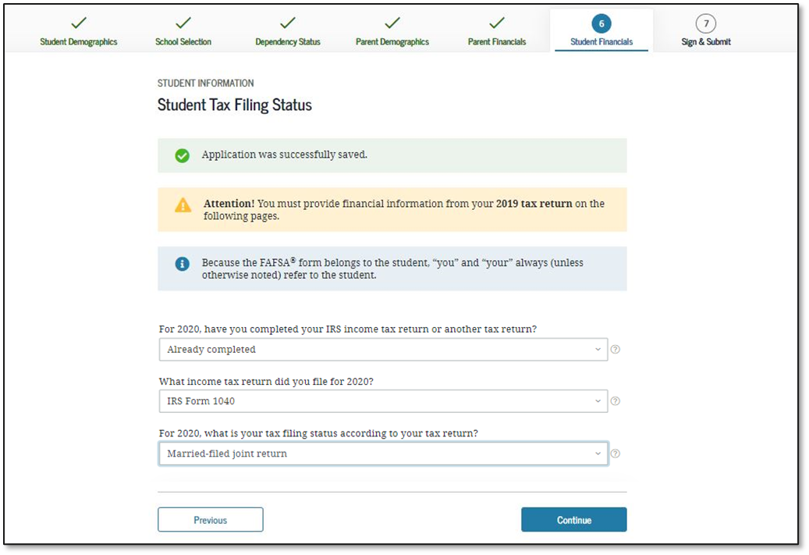
Student Tax Filing Status
Notes:
Student Tax Filing Status view
This is first view in the Student Financials section.

Slide 56
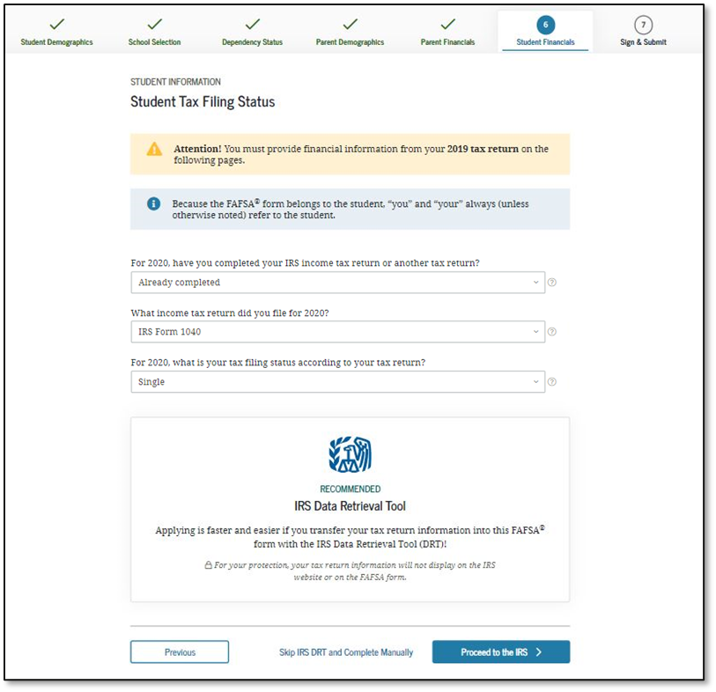
Student Tax Filing Status Dependent
Notes:
Student Tax Filing Status view
This view is displayed when the user chooses not to use the IRS Data Retrieval Tool on the previous view. An additional opportunity is presented to the user to determine if he or she would like to link to the IRS for his or her financial information or to continue to enter it manually.

Slide 57

Student Eligible for IRS Data Retrieval Tool (DRT)
Notes:
Student Eligible for IRS Data Retrieval Tool (DRT) view

Slide 58

Student IRS Info
Notes:
Student IRS Info view
Note: If the user is either ineligible or decides not to use the IRS DRT, he or she will be required to enter his or her financial information manually.

Slide 59

Student Income from Work
Notes:
Student Income from Work view

Slide 60

Student Additional IRS Info
Notes:
Student Additional IRS Info view

Slide 61

Student Questions for Tax Filers Only
Notes:
Student Questions for Tax Filers Only view

Slide 62

Student Additional Financial Info
Notes:
Student Additional Financial Info view

Slide 63

Student Untaxed Income
Notes:
Student Untaxed Income view

Slide 64

Student Assets
Notes:
Student Assets view

Slide 65

Preparer Info
Notes:
Preparer Info view
New: The Preparer view will now only show if someone has logged in under the Preparer role.

Slide 66

FAFSA Summary
Notes:
FAFSA Summary view

Slide 67


FAFSA Summary 1
Notes:
FAFSA Summary view – Student Demographics and School Selection
Note: Users can use the hyperlinks in the summary to edit any question in the form.

Slide 68


FAFSA Summary 2
Notes:
FAFSA Summary view (continued) – School Selection and Dependency Status

Slide 69


FAFSA Summary 3
Notes:
FAFSA Summary view (continued) – Parent Demographics and Parent Financials

Slide 70


FAFSA Summary 4
Notes:
FAFSA Summary view (continued) – Parent Financials Continued

Slide 71



FAFSA Summary 5
Notes:
FAFSA Summary view (continued) –Student Financials and Sign and Submit

Slide 72

Agreement of Terms
Notes:
Agreement of Terms student view
This is where the student acknowledges the Certification Statement.

Slide 73

Signature Status
Notes:
Signature Status view
The student’s signature was accepted, and now the parent will need to sign.

Slide 74

Parent Signature Selection
Notes:
Parent Signature Selection view
The choice between parents is only present if information was provided for two parents. Otherwise, this view does not display.

Slide 75

Agreement of Terms Dependent
Notes:
Agreement of Terms parent view
This is where the parent acknowledges the Certification Statement.

Slide 76

Signature Options
Notes:
Signature Options view

Slide 77


Confirmation Page
Notes:
Confirmation Page view

Slide 78
Independent Student and IRS DRT Flow
Notes:
Independent Student and IRS DRT Flow

Slide 79
Personal Information for Student Independent
Notes:
Personal Information for Student view
This is one of multiple pages on fafsa.gov that explains that “you” and “your” are referencing the student. Other pages where this messaging appears includes the "Search for High School," "Student Marital Status," "Parent Marital Status," and "Student Tax Filing Status."
Note: This is the first view for the Student Demographics section.

Slide 80
Student Email and Phone Independent
Notes:
Note: It is beneficial for the student to include an email address on the FAFSA form in order to receive important communications about the student’s financial aid.

Slide 81
Student Address Independent
Notes:
Student Address view

Slide 82
Student Residency and Eligibility Independent
Notes:
Student Residency and Eligibility view

Slide 83
Student Education Independent
Notes:
Student Education view

Slide 84
Student Selective Service Independent
Notes:
Note: The response to this question doesn't affect eligibility the applicant’s eligibility for federal student aid.

Slide 85
Student Driver’s License Independent
Notes:
Student Driver’s License view

Slide 86
Student Foster Care and Parent Education Completion Independent
Notes:
Student Foster Care and Parent Education Completion view

Slide 87
Student Eligibility Worksheet Independent
Notes:
Student Eligibility Worksheet view

Slide 88
Search for High School Independent
Notes:
Search for High School view
Note: This is the first page for the School Selection section.

Slide 89
Add Your High School Manually Independent
Notes:
Add Your High School Manually view

Slide 90
High School Search Results Independent
Notes:
High School Search Results view

Slide 91
Confirm Your High School Independent
Notes:
Confirm Your High School view

Slide 92
College Search Independent
Notes:
College Search view

Slide 93
College Search Results Independent
Notes:
College Search Results view

Slide 94
Search by Federal School Code Independent
Notes:
Search by Federal School Code view

Slide 95
Selected Colleges and Housing Info I
Notes:
Selected Colleges and Housing Info view
Note: Users can reorder schools on this page which will not affect federal aid but can affect state/school aid.

Slide 96
Student Marital Status Independent
Notes:
Student Marital Status view
Note: This is the first page of the Dependency Status section.

Slide 97

Does the Student Have Dependents? Independent
Notes:
Does the Student Have Dependents? view
Note: In this view, the student has dependents

Slide 98

Student Household Info Independent
Notes:
Student Household Info view
Note: This view is only available if the student has dependents.

Slide 99

Independent Student Status Independent
Notes:
Independent Student Status view
This view only displays if it has been determined that the user is considered to be an independent student. Generally, independent users have the choice of whether to answer questions about their parents; however, some health professions or law schools may require parent information.

Slide 100

Student Tax Filing Status Independent
Notes:
Student Tax Filing Status view
Note: This is the first view of Student Financials section.
Parent demographics and financials have been skipped because the user is independent and chose to skip them.

Slide 101

Leaving the FAFSA.gov Pop-up Independent
Notes:
Student Leaving the fafsa.gov pop-up view

Slide 102

IRS Website Disclaimer Independent
Notes:
IRS Website Disclaimer view

Slide 103

Get My Federal Income Tax Information Independent
Notes:
Get My Federal Tax Income Information view
This is where the user provides tax information exactly as it appears on his or her tax return. Some information will be prefilled from the FAFSA form such as name, Social Security number, date of birth, and tax filing status.

Slide 104

Federal Income Tax Information Results Independent
Notes:
Federal Income Tax Information Results view
This page gives the user the opportunity to check the box and then transfer his or her federal tax information into the FAFSA form.

Slide 105

Student IRS Info Independent
Notes:
Student IRS Info view

Slide 106

Student Income from Work Independent
Notes:
Student Income from Work view

Slide 107

Student Simplified Path Determination Independent
Notes:
Student Simplified Path Determination view
Note: The Schedule 1 question and associated help text have been updated to include all of the exceptions to answering this question.
In addition, the Schedule 1 question is now a field that can be transferred from the IRS DRT.
The Schedule 1 question may be enabled based on previously answered questions.

Slide 108

Student Additional IRS Info Independent
Notes:
Student Additional IRS Info view

Slide 109

Student Questions for Tax Filers Only Independent
Notes:
Student Questions for Tax Filers Only view

Slide 110

Student Additional Financial Info Independent
Notes:
Student Additional Financial Info view

Slide 111

Student Untaxed Income Independent
Notes:
Student Untaxed Income view

Slide 112

Student Assets Independent
Notes:
Student Assets view

Slide 113
Preparer Info Independent
Notes:
Preparer Info view
New: The Preparer view will only show if someone has logged in under the Preparer role.

Slide 114
FAFSA Summary (Authenticated User) Independent
Notes:
“FAFSA Summary” (Authenticated User) view

Slide 115
FAFSA Summary (Authenticated User) 1 Independent
Notes:
“FAFSA Summary” (Authenticated User) view – Student Demographics and School Selection

Slide 116
FAFSA Summary (Authenticated User) 2Independent
Notes:
“FAFSA Summary” (Authenticated User) view (continued) – School Selection and Dependency Status

Slide 117
FAFSA Summary (Authenticated User) 3Independent
Notes:
“FAFSA Summary” (Authenticated User) view (continued) – Student Financials and Sign and Submit

Slide 118

Agreement of Terms (Authenticated User) Independent
Notes:
Agreement of Terms (Authenticated User) student view
This is where the user acknowledges the Certification Statement.

Slide 119
Confirmation Page (Authenticated User) Independent
Notes:
Confirmation Page (Authenticated User) view

Slide 120
FAFSA Summary (Unauthenticated User) Independent
Notes:
FAFSA Summary (Unauthenticated User) view

Slide 121
FAFSA Summary (Unauthenticated User) 4 Independent
Notes:
“FAFSA Summary” (Unauthenticated User) view – Student Demographics and School Selection.
Note: Users can use the hyperlinks in the summary to edit any question in the form.

Slide 122
FAFSA Summary (Unauthenticated User) I 3
Notes:
FAFSA Summary (Unauthenticated User) view (continued) – School Selection and Dependency Status

Slide 123
FAFSA Summary (Unauthenticated User) I 2
Notes:
FAFSA Summary (Unauthenticated User) view (continued) – Student Financials and Sign and Submit

Slide 124


Agreement of Terms
(Unauthenticated User) Independent
Notes:
Agreement of Terms (Unauthenticated User) student view
This is where the user acknowledges the Certification Statement.

Slide 125

Signature Options
(Unauthenticated User) Independent
Notes:
Signature Options (Unauthenticated User) view

Slide 126

Confirmation Page (Unauthenticated User) Independent
Notes:
Confirmation Page (Unauthenticated User) view

Slide 127
My FAFSA® Views
Notes:
My FAFSA View
My FAFSA view(s) appear when a user or parent logs into the FAFSA landing page and has a transaction is on file.

Slide 128
My FAFSA® View
The My FAFSA® view is a navigation tool for the user when accessing the FAFSA Form.
The view provides the following dynamic options and messaging based on the user’s FAFSA® form status:
  Start a 2022–23 FAFSA Form
  Complete and submit a FAFSA® Renewal
  Action Required
  Continue or Start Over
  Application Processed Successfully
  View the Student Aid Report (SAR)
  User Account Management
Notes:
My FAFSA view
Users can also choose between different cycles from the My FAFSA view when both cycles are active

Slide 129
Start a 2022–23 FAFSA® Form
Notes:
Start a 2022–23 FAFSA Form

Slide 130

Start a 2022–23 FAFSA® Form
Notes:
Start a 2022–23 FAFSA® Form view
If the applicant does not have any existing FAFSA data on file, he or she can start a new FAFSA form. If the applicant does have a FAFSA form on file, then he or she will have the option to select "Start Over" to begin a new form.

Slide 131
Complete and Submit a FAFSA® Renewal
Notes:
Complete and Submit a FAFSA® Renewal

Slide 132

Renew My FAFSA® form
Notes:
Renew My FAFSA® view
An applicant that is starting a new FAFSA for the cycle but had submitted a form the previous cycle will be able to select “Renew my FAFSA Form.” Only students can start a renewal.

Slide 133
Continue or Start Over
Notes:
Continue or Start Over

Slide 134

Continue or Start Over 2
Notes:
Continue or Start Over view
If the applicant does have a FAFSA form on file, he or she will have the option to select "Start Over" to begin a new form or "Continue” to resume completion of an already existing FAFSA Form.

Slide 135
Action Required
Notes:
Action Required

Slide 136

Action Required 2
Notes:
Action Required view
If the applicant’s submitted form has not been processed, an "Action Required" screen will notify the applicant of the reason and what to do next.

Slide 137
Application Processed Successfully
Notes:
Application Processed Successfully

Slide 138

Application Processed Successfully 2
Notes:
Application Processed Successfully view
Once the application has been processed successfully, this view will display a "Congratulations" message and information about what happens next.

Slide 139
View the Student Aid Report (SAR)
Notes:
View the Student Aid Report

Slide 140

View the Student Aid Report (SAR) 2
Notes:
View Student Aid Report (SAR) view
Once the Student Aid Report has been generated, the applicant may select "View Student Aid Report" on the year selection page.

Slide 141

Processing Results Tab
Notes:
Processing Results Tab view
Upon selecting “View Student Aid Report,” applicant will be brought to the “Processing Results” view where he or she will see information about the Expected Family Contribution (EFC).

Slide 142

FAFSA Data Tab
Notes:
FAFSA Data Tab view
On the FAFSA Data view, the user will select the FAFSA Data tab, which shows the information provided on the FAFSA form.

Slide 143

FAFSA Data (1 of 5)
2022-2023
2022-2023:
Notes:
FAFSA Data
The "Student Information" view displays how the user answered all relevant questions in this section.

Slide 144

FAFSA Data (2 of 5)
Notes:
FAFSA Data (2 of 5) view – Student’s School Information and Student Dependency Status
The user will scroll down to view additional information he or she provided, including the student's school information and student dependency status.

Slide 145

FAFSA Data (3 of 5)
Notes:
FAFSA Data (3 of 5) view
The user will continue to scroll to view other sections completed. In this screen, the user provided parent information and parent financial information.

Slide 146

FAFSA Data (4 of 5)
Notes:
FAFSA Data (4 of 5) view
The user will continue scrolling to view student financial information. If the parent or student used the IRS DRT, then that information will be masked with "Transferred from the IRS" in the relevant financial fields.

Slide 147

FAFSA Data (5 of 5)
2020 income tax
2020 Tax Form
2020 Tax Return Filing
2020 Adjusted Gross
2020 U.S. Income Tax Paid:
2020 Income Earned from
2020 Income Earned from
10/01/2021
Notes:
FAFSA Data (5 of 5) view
The user will scroll to review the remaining sections, including the signature information. It also includes "Back to FAFSA Home" button if the user wishes to return to the FAFSA landing page.

Slide 148

School Information
Notes:
School Information view
The “School Information” tab provides graduation, retention, and transfer information about all the schools the user selected on the FAFSA form.

Slide 149

Financial Aid History
Notes:
Financial Aid History (1 of 2) view
In the "Financial Aid History" tab, the user can view the federal student loans to date, including William D. Ford Federal Direct Loans, Federal Family Education Loans (FFEL), and Federal Perkins Loans. It also includes a link to the Aid Summary feature.

Slide 150


Financial Aid History 2
Notes:
Financial Aid History (2 of 2) view
The user can expand and collapse the financial aid information, which includes loan type, total principal balance, remaining amount to be disbursed, and total.

Slide 151

Corrections History
Notes:
Corrections History view
Any corrections the user has made to this cycle year's FAFSA form is included in the “Corrections History” tab. The user can start a new correction directly from this view.

Slide 152
User Account Management
Notes:
User Account Management

Slide 153

User Account Management 2
Notes:
User Account Management view
The user can view information associated to his or her FSA ID, including the status of the FSA ID and associated identifiers to the FSA ID. This section is found on the My FAFSA view and will display when a user has multiple sets of historical identifiers.

Slide 154

Account Information
Notes:
Account Information view
The user can update his or her Account Information, along with Personal Information, Contact Information, and Communication Preferences on the "Settings" page.

Slide 155
FAFSA® Corrections
Notes:
FAFSA Corrections

Slide 156

My FAFSA ®
Notes:
My FAFSA view for corrections
Users will select “Update Schools” to add, remove, or change housing plans for schools and select “Edit FAFSA form” to change incorrect information on a previous FAFSA submission.
Note: The corrections have been updated with an entirely new look/user experience.

Slide 157

Make Corrections
Notes:
Make Corrections view for corrections
If an applicant is starting a new correction, he or she will have to create a correction save key.

Slide 158

FAFSA ® Form Sections
Notes:
FASA Form Sections view for corrections
Note: Users may select “Enter Section” to jump to a specific section where thet would like to make edits. Each section contains editable fields relating to the specific section title.

Slide 159

Student Demographics
Notes:
Student Demographics view for corrections

Slide 160


Student Eligibility
Notes:
Student Eligibility view for corrections

Slide 161

Confirm Your High School
Notes:
Confirm Your High School view for corrections

Slide 162

Selected College and Housing Info
Notes:
Selected College and Housing Info view for corrections

Slide 163

Dependency Determination
Notes:
Dependency Determination view for corrections

Slide 164

Dependency Status Results
Notes:
Dependency Status Results view for corrections

Slide 165

Parent Demographics
Notes:
Parent Demographics view for corrections

Slide 166

Parent Information
Notes:
Parent Information view for corrections

Slide 167

Parent Information 2
Notes:
Parent Information view for corrections

Slide 168

Parent Financials
Notes:
Parent Financials view for corrections

Slide 169



Parent Financials 2
Notes:
Parent Financials (continued) view for corrections

Slide 170

Student Financials
Notes:
Student Financials view for corrections

Slide 171



Student Financials 2
Notes:
Student Financials (continued) view for corrections.

Slide 172

Sign and Submit
Notes:
Sign and Submit view for corrections

Slide 173

Confirmation
Notes:
Confirmation view for corrections

Slide 174
Special Circumstances/Special Circumstances With Unsubsidized Loan Only
Notes:
Special Circumstances/Special Circumstances With Unsubsidized Loan Only

Slide 175

Dependent Student Status View
Notes:
Dependent Student Status view
If the dependent user is unable to provide parental data on the FAFSA form, he or she should select “I am unable to provide information about my parent(s).” Once the user selects "Continue,“ he or she will go to the “mpact of not Providing Parent Information view.

Slide 176

Impact of Not Providing Parent Information
Notes:
Impact of Not Providing Parent Information view
This view notifies the user that although he or she is allowed to skip parent information, an EFC will not be generated, and he or she must follow up with the financial aid administrator in order to complete his or her FAFSA form and receive an EFC. Once the user selects “Continue,” he or she will go to the Special Circumstances Qualifications view (only if the user has not confirmed his or her special circumstances).

Slide 177


Special Circumstances Qualifications
Notes:
Special Circumstances Qualifications view
The user will be given examples of what would and wouldn't be considered special circumstances.
On the Special Circumstances Qualifications view, the user may either
correct his or her response from the previous view and provide parental information;
select “I have a special circumstance and I am unable to provide information about my parent(s);" or
select “I do not have a special circumstance, and I am submitting my FAFSA form without parent information to apply for an unsubsidized loan only."
In this example, the user has selected “I do not have a special circumstance and am unable to provide information about my parent(s).” The user can then select “Continue,” which will bring them to section 6 to provide student information.

Slide 178
Homelessness Circumstances
Notes:
Homelessness Circumstances

Slide 179

Student Homelessness Filter Question
Notes:
Student Homelessness Filter Question view
On this view, the user may select "Yes" or "No" to the question if he or she were homeless or self-supporting and at risk on or after July 1, 2021.

Slide 180

Student Homelessness Questions
Notes:
Student Homelessness Questions view
The user has the option to select which entity made the determination or “None of the above.”
In this example, the user choses one of the three entities listed.
Once the user selects "Continue," he or she will go to the Independent Student Status view to answer if he or she would like to provide parental information.

Slide 181

Independent Student Status
Notes:
Independent Student Status view
The user may select "Yes" or "No" to answer questions about his or her parents.

Slide 182

Student Homelessness Questions View
Notes:
Student Homelessness Questions view
In this example, the user chose "None of the above."
Once the user selects “Continue," he or she will go to the Homeless or At Risk of Being Homeless view.

Slide 183

Homeless or At Risk of Being Homeless
Notes:
Homeless or At Risk of Being Homeless view
This view describes the conditions for being homeless or at risk of being homeless. Once the user selects “Continue,” he or she will go to the page that describes the potential impacts of not providing parent information.

Slide 184
Impact of Not Providing Parent Information 2
Notes:
Impact of Not Providing Parent Information view
This view notifies the user that although he or she is allowed to skip parent information, an EFC will not be generated and he or she must follow up with the financial aid administrator in order to complete his or her FAFSA form and receive an EFC.

Slide 185

Homeless or At Risk of Being Homeless Acknowledgement
Notes:
Homeless of At Risk of Being Homeless Acknowledgment view
Users who are homeless or at risk of being homeless may select whether to provide information about their parents.

Slide 186
Additional Resources
Notes:
Additional Resources

Slide 187

My Documents
Notes:
My Documents view
The user can track the status of a completed FAFSA form within the "My Documents" page. To go to the "My Documents" page, the user must log in, select his or her name from the top right, and select "My Documents."

Slide 188

Notifications
Notes:
Notifications view
The user can view any notifications relevant to the FAFSA form in the Notifications Center. The user must be logged in to view any notifications. If there are any notifications, the bell icon in the top right corner will contain a red circle with a number to indicate the number of notifications.

Slide 189

Conclusion
Notes:
Conclusion

